Slide 1
ISTeC NSF Networking Grant
Scott Baily
Director, ACNS Colorado State University

Slide 2
Outline
Background on the NSF Proposal
CSU’s response and subsequent award
Core networking upgrades, “Science DMZ”
Comments, feedback and discussion

Slide 3
NSF’s Solicitation
Campus Cyberinfrastructure – Network Infrastructure and Engineering (CC-NIE)
Available only to Higher Ed
The latest in a series of funding opportunities from the NSF focusing on infrastructure
Remember vBNS and High Performance Connections Program from the 1990’s?
Continues where the National Broadband Plan and NTIA funding for middle-mile projects left off

Slide 4
CC-NIE Solicitation
Released March 1, 2012
Due May 30, 2012
Unusually short response time
Two focus areas of opportunity
Area 1: Data driven networking infrastructure for benefit of campus and/or researchers
$500K limit over 2 years
Area 2: Network integration & applied innovation
$1M limit over 2 years

Slide 5
Important Funding Criteria
Motivation
Architecture
Advanced Services
Data Transfer Nodes
Performance Monitoring
Security

Slide 6
CC-NIE Solicitation (Cont’d)
NSF Estimated making 10-20 awards
90 proposals were received, requesting $52M
~ $575K average per proposal
39 awards for 34 projects, $21.6M allocated
23 States represented
Area 1: Sci./Eng. drivers – clear sci. partnerships
21 awards, $9.7M total
CSU received $487K
Area 2: 18 awards, $11.9M total

Slide 7
CSU’s Response
“CC-NIE Data-Driven Network Infrastructure Upgrade for Colorado State University (CSU)”
Pat Burns, PI
HJ Siegel and Scott Baily, co-PI’s
Proposes to address the big data needs of our researchers
Upgrade the core campus infrastructure, and
Create a “Science DMZ”

Slide 8
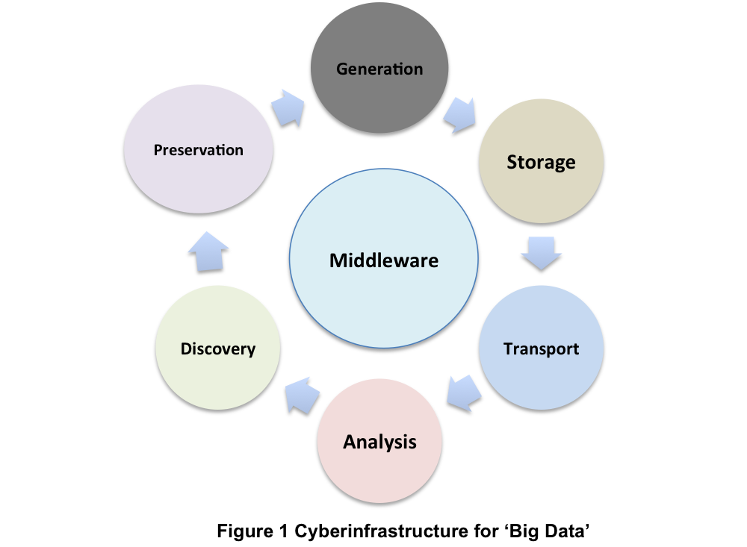
CI needed to support Big Data

Slide 9
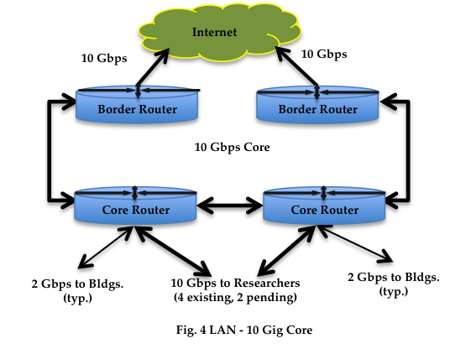
CSU’s core network today

Slide 10
Objectives
Upgrade the core data network from 10 Gbps to at least 40 Gbps, or preferably, 100 Gbps
Establish a “Science DMZ” (@ 40 / 100 Gbps)
Create a new, dedicated WAN path for research traffic to enable collaboration
Implement dynamic routing and performance monitoring, leveraging Internet2’s DYNES solution/architecture

Slide 11
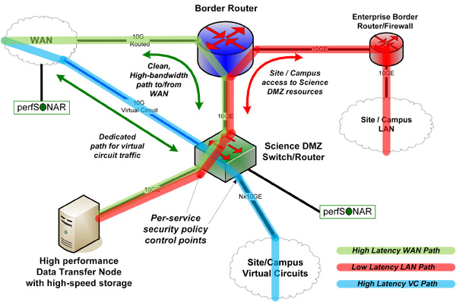
“Simple” DMZ (ESNET design)

Slide 12
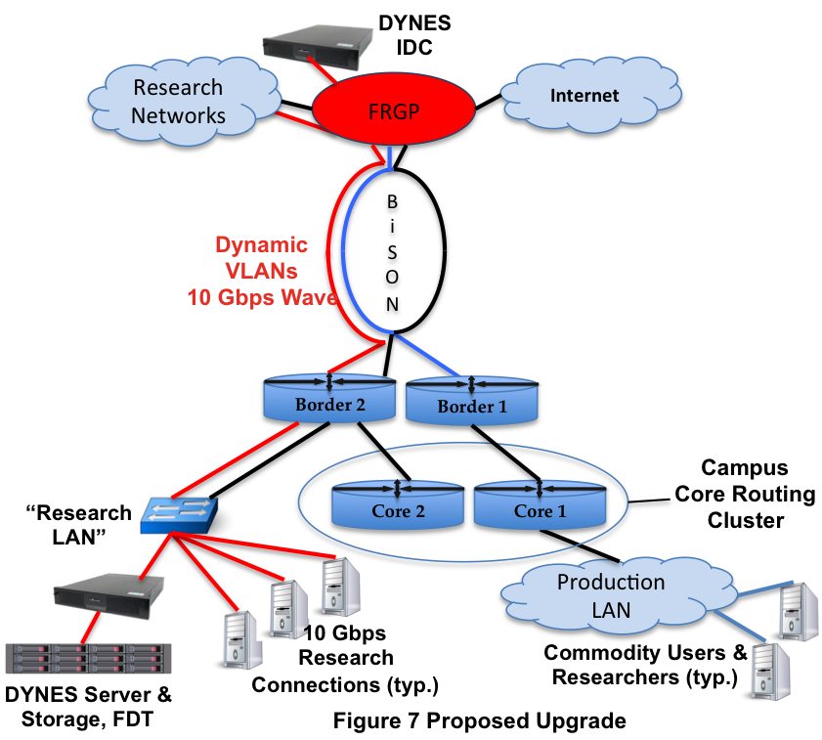
Science DMZ applied at CSU

Slide 13
Most Significant Challenges
Personnel resources
Networking staff already extremely bus
VoIP, Wireless, Campus and Wide area networking
Highly motivated to stick with known vendors
Budget
100 Gbps is expensive!
However, may still be possible to leapfrog 40 Gbps
Security
Devices in DMZ will be outside campus firewall…
Setting the stage for the mother of all DOS attacks?

Slide 14
Discussion and Comment
What are your thoughts about the utility of the Science DMZ?
Is 40 Gbps sufficient? 100Gbps?
How do you envision this being useful to you?
Thoughts, suggestions, ideas?
Questions?

Slide 15
Thank you

