Slide 1
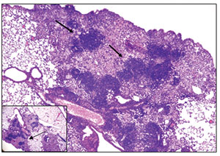
Biological Data Management and Preservation
Richard Slayden, PhD.
Microbiology, Immunology & Pathology

Slide 2
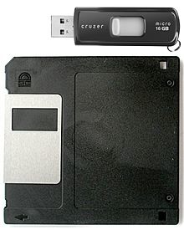
CURRENT DATA MANAGEMENT & PRESERVATION STRATEGIES USED BY BIOLOGISTS
Data Management
Data Preservation
Notes:
Different levels of technology integration

Slide 3
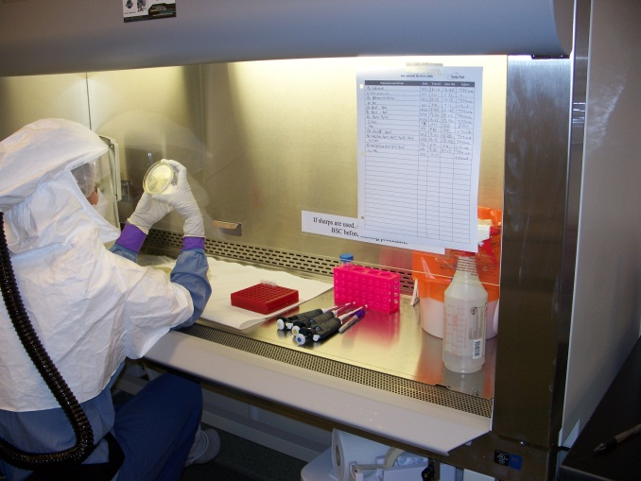
What experimental data makes up information?
Study Design
Experiment
Complexity
Data Reduction
Analysis
Information
Notes:
Many sources of data needs to be managed and associated with the data for the information to be useful

Slide 4
Current data issues
Sequencing: 1-400 genomes (bacterial)
Analysis: reference annotation vs re-annotation
Source of data: Historical data or newly generated
Integration of biological information, data complexity and “version”

Slide 5
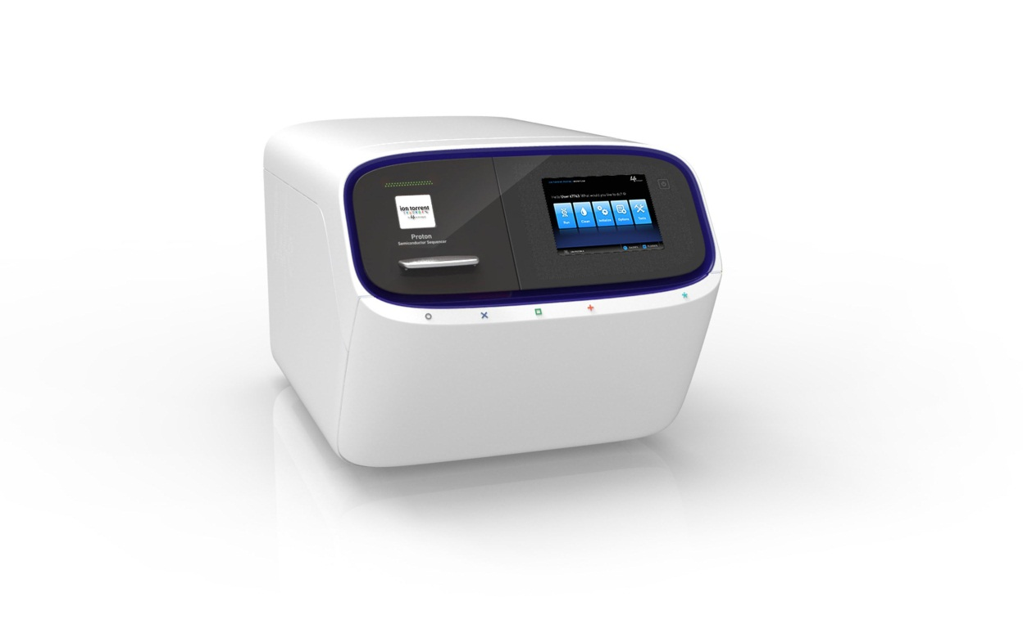
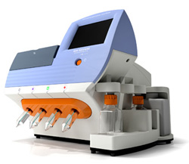
Example of where data is coming from: Next Generation Sequencing Technology

Slide 6
Examples of biological data: Not limited to genome sequencing
Reference or De Novo Genome sequence data
Resequencing/SNP Analysis
Whole Transcriptome/small RNA/microbial RNA/human RNA
Epigenetics
Gene Essentiality
Metagenomic studies

Slide 7
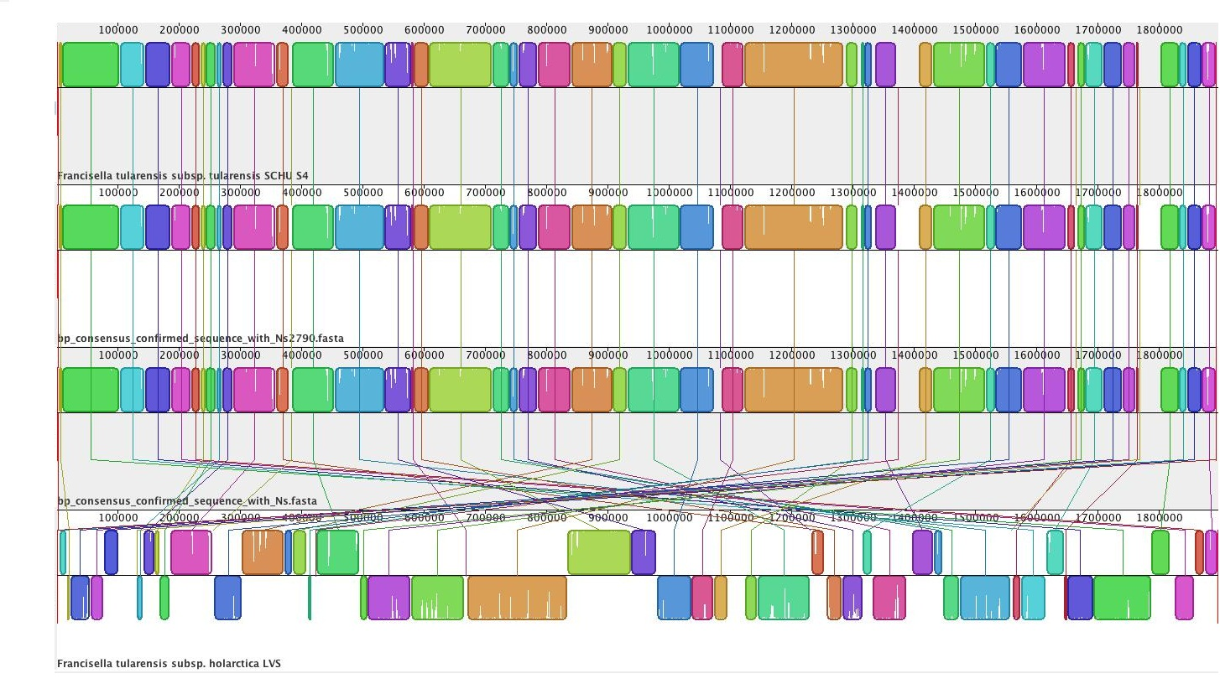
Integration of data: Genome Analysis-Genome structure and arrangement
Schu4
Isolate #1
Isolate #2
LVS

Slide 8
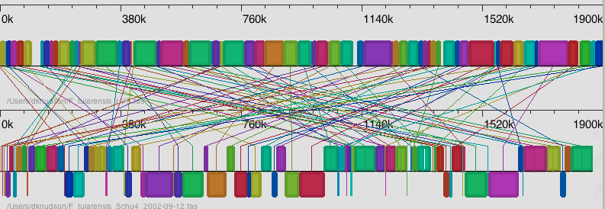
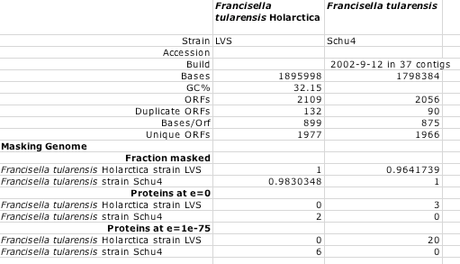
Capturing and Updating Biological information and Function

Slide 9
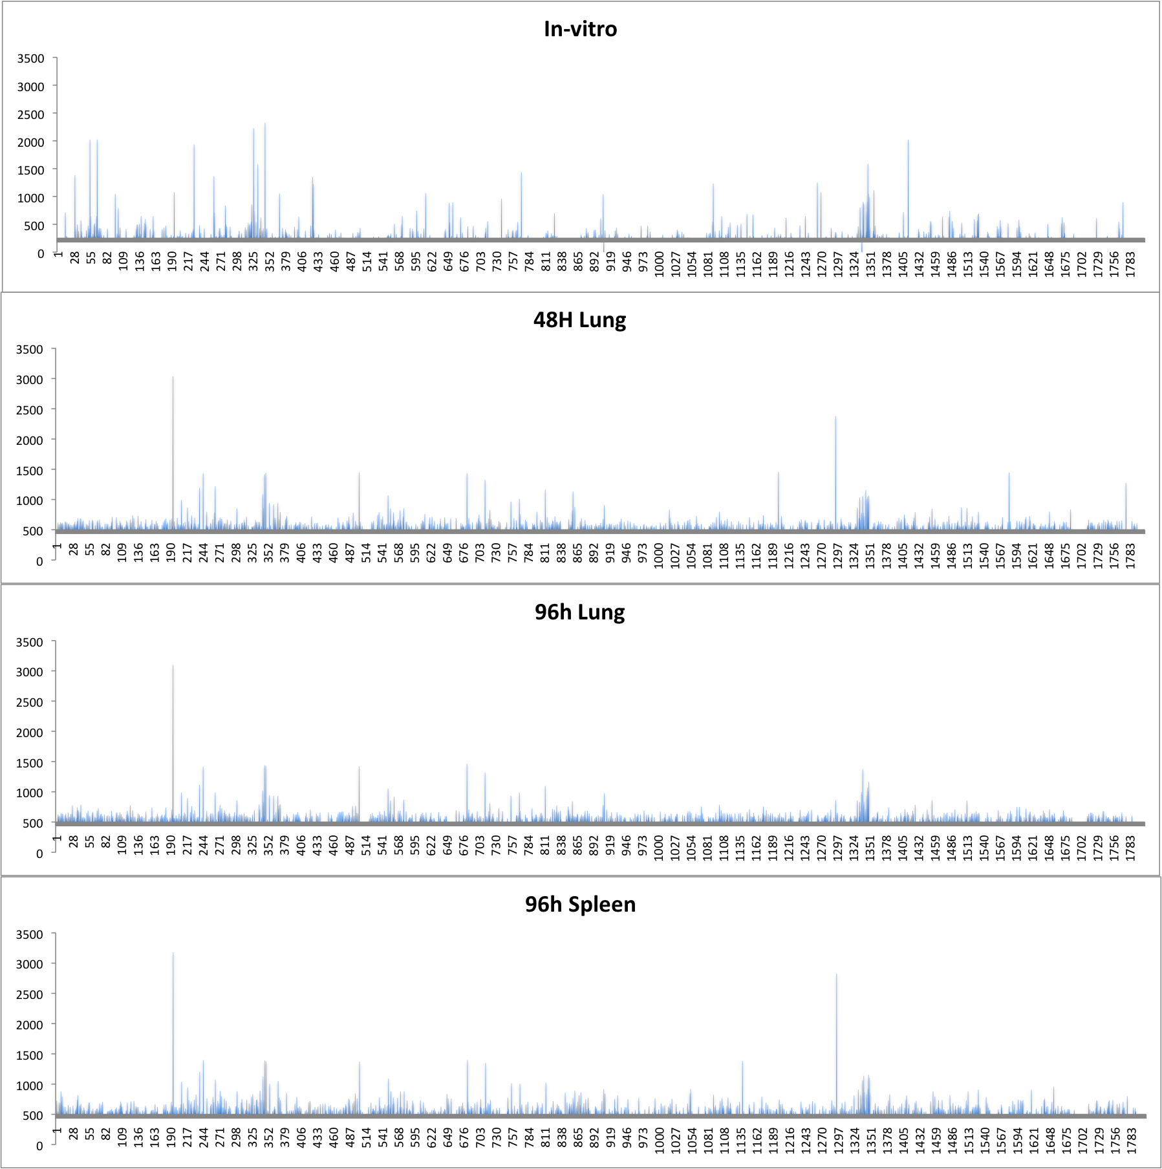
RESOLUTION OF DATA-UNIQUE DATA FROM A SINGLE INFECTION

Slide 10
IDENTIFICATION OF NEW GENOMIC INFORMATION: Assignment of Function
RPKM
Annotated open reading frames
RPKM
Non-annotated open reading frames

Slide 11
INTEGRATION OF DIFFERENT SOURCES OF DATA
Whole genome essential gene mapping
NS SNPs
+ORFs
-ORFs
Genome size: ~1.9 million bases
Input pool: 196,044 mutations (~10%)
Bacteria from lung: 179,782 mutations
Bacteria from Spleen: 77,806 mutations
Mapped 1,419 unique non-synonymous SNPs across the genome
74% are within proposed open reading frames

Slide 12
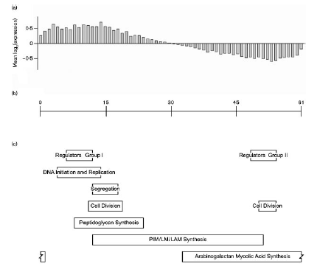
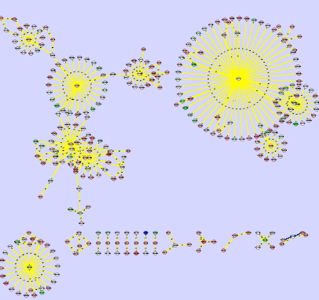
GENOME AND “FUNCTIONAL” INFORMATION
Combine bioinformatics [promoter families] and transcriptional analysis

Slide 13
Future data management and preservation
Envisioned Needs in context of the BIOLOGIST:
Data Storage-where is the data
Access & maintenance-has it been changed, if so in what way, and by who, and for what reason
Access to data files-interface with data for manipulation and data analysis & output
Distribution of data files-Provide data in “universal” format where state of analysis is embedded and can be integrated with other data
Compatibility of analytical software and future interfaces

Slide 14
Questions:

